Slide 1
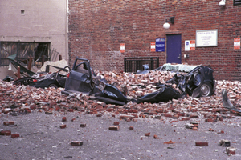
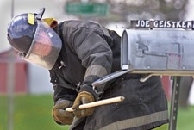
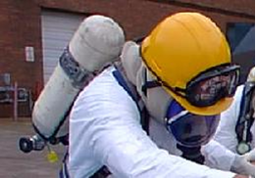
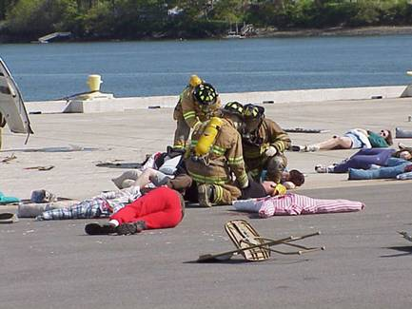
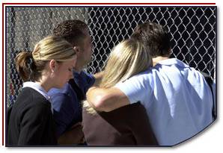
Disaster Site Worker Safety
Safety Hazards

Slide 2
Objectives
Anticipate hazards associated with disaster sites.
Apply hazard recognition to disaster site operations.
Evaluate and control identified hazards.
Apply hierarchy of control.
List indicators of unstable structure integrity.
Describe how implementation of an Incident Command System can assist in minimizing exposure to structural collapse hazards.
List some confined spaces that may be created by a disaster incident.

Slide 3
Building Assessment, demolition & restoration
Roof Inspection, Tarping, and Repair
Building Demolition
Assessment, Cleanup, and Repair of Structures
Removal of Floodwaters from Structures and Initial Entry into Previously Flooded Areas
Mold Remediation
Hazard Exposure and Risk Assessment Matrix Assessment Sheets.

Slide 4
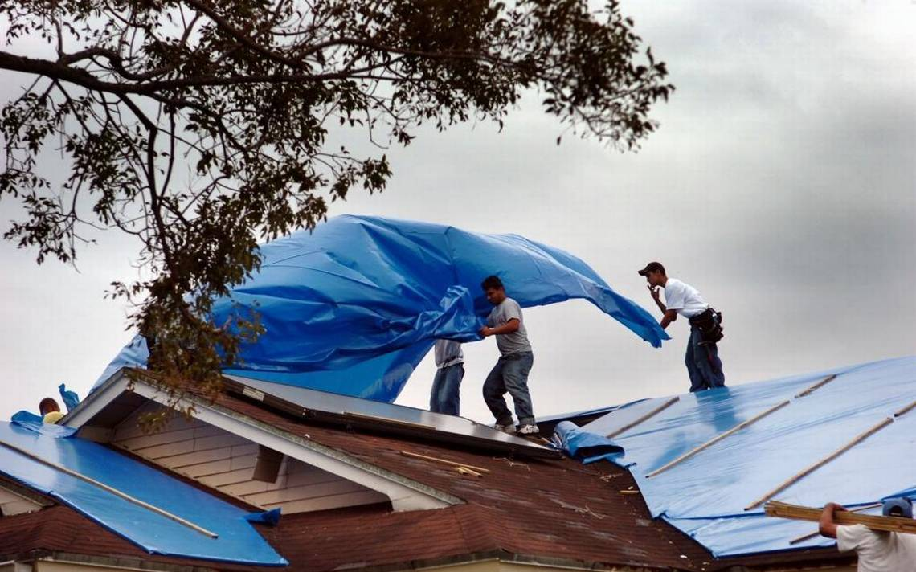
Building Assessment, demolition & restoration
Roof Inspection, Tarping, and Repair
Fall protection concerns are found at over three-quarters of the work sites. Safety-monitoring systems and fall protection (harnesses, lanyards, lifelines, connectors, anchorages, and anchorage points) will be used.
Other common concerns include improper use of ladders and scaffolds, PPE issues, and electrocution and shock hazards from power lines and power tools. PPE was either not being worn when needed, or the PPE selected did not provide adequate protection.
Lack of Fall Protection – OSHA # 1 cited violation!

Slide 5
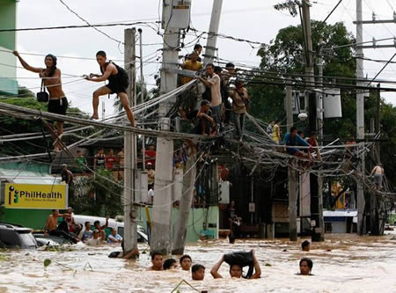
Building Assessment, demolition & restoration
Removal of Floodwaters from Structures and Initial Entry into Previously Flooded Areas
Contact with downed lines & live electrical equipment and other utilities (gas, water)
Downed electrical conductors can energize other objects, including fences, water pipes, bushes, trees, and telephone/CATV/fiber optic cables

Slide 6
Waste / debris removal & reduction
Debris Collection
Debris Reduction, Recycling, and Disposal
Tree Trimming
Vehicle Removal and Salvage
Hazard Exposure and Risk Assessment Matrix Assessment Sheets.

Slide 7
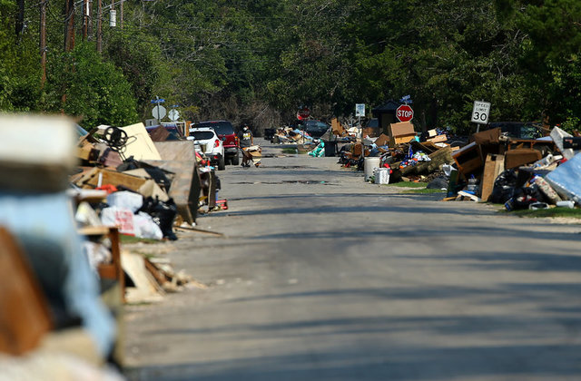
Waste / debris removal & reduction
Debris Collection
Work zone safety concerns are found at over half the work sites. Work areas should be adequately marked or separated with signs, cones or barricades.
Other common concerns included PPE issues and workers at risk of being struck by machinery or falling debris. PPE was either not being worn when needed, or the PPE selected did not provide adequate protection.

Slide 8
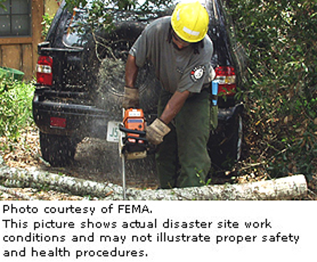
Waste / debris removal & reduction
Tree Trimming
Response and recovery workers involved in tree trimming work at heights, gain access by using aerial lifts or by climbing. They then typically use power tools (usually chain saws) to cut branches, limbs, and trunks as necessary.

Slide 9
Infrastructure repair & restoration
Roadway and Bridge Inspection and Repair
Sand/Sludge Removal
Community Floodwater Removal and Levee Repair
Restoring Electrical Utilities
Restoring Communications Systems
Restoring Water and Sewer Services
Hazard Exposure and Risk Assessment Matrix Assessment Sheets.

Slide 10
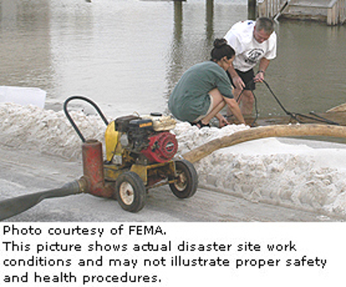
Infrastructure repair & restoration
Community Floodwater Removal and Levee Repair
Tasks include inspecting and repairing levees and stationary pumping systems, as well as using portable pumping systems and generators. Recovery workers might access levees and pumps by vessel, vehicle, helicopter, or on foot.
Exposures require additional protections and PPE such as a lifesaving skiff and a ring buoy.

Slide 11
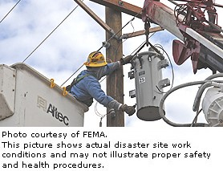
Infrastructure repair & restoration
Restoring Electrical Utilities
Requires specially trained and qualified technicians.
Utility workers conducting assessment and repair activities should already be familiar with safe work practices and personal protective equipment.
Work zone safety concerns are found at just under half the work sites.
When aerial lifts are used, fall protection must be used and properly anchored.
Notes:
Requires specially trained and qualified technicians, often from other areas of the country, to assess and repair the damage area-by-area.
Utility workers conducting assessment and repair activities should already be familiar with safe work practices and personal protective equipment.
Other common concerns include PPE issues, especially for exposure to shock and electrocution hazards when live, or potentially live, equipment is not properly insulated or grounded.
This work will involve the use of specialized electrical-isolation equipment, frequent use of aerial lifts and ladders, and entry into confined spaces. Typically work areas are not adequately marked or separated with signs, cones or barricades.

Slide 12
Community support & public health services
Search and Rescue Removing Human and Animal Remains Public Safety (Law Enforcement and Emergency Medical Services) Locating and Establishing Temporary Housing Facilities Locating, Collecting, and Housing Stray Animals
Hazard Exposure and Risk Assessment Matrix Assessment Sheets.

Slide 13
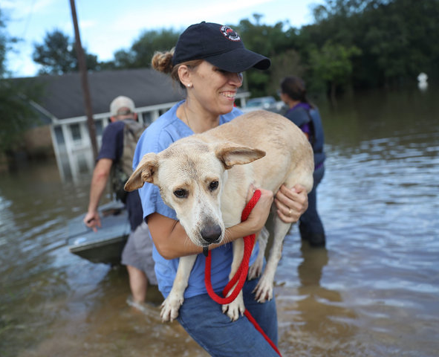
Community support & public health services
Locating, Collecting, and Housing Stray Animals
Hurricanes Katrina and Rita (2005): The American Society for the Prevention of Cruelty to Animals estimates that over 8,000 dogs, cats, horses, livestock, and other wild and exotic animals were rescued in Mississippi and Louisiana.
Be on guard for wild or stray animals as they exhibit unpredictable or aggressive behavior.
Disaster site workers who identify a wild or stray animal that needs to be recovered and cared for should call the local animal control officer or report the animal to the incident management staff through their supervisor. Protective bite-proof body armor including face shields and gloves should be used when recovering animals.
Notes:
Locating, Collecting, and Housing Stray Animals
Hurricanes Katrina and Rita (2005): The American Society for the Prevention of Cruelty to Animals estimates that over 8,000 dogs, cats, horses, livestock, and other wild and exotic animals were rescued in Mississippi and Louisiana.
Be on guard for wild or stray animals as they exhibit unpredictable or aggressive behavior. Because these animals may be frightened, malnourished, injured, or diseased, they may not react predictably.
Disaster site workers who identify a wild or stray animal that needs to be recovered and cared for should call the local animal control officer or report the animal to the incident management staff through their supervisor. Protective bite-proof body armor including face shields and gloves should be used when recovering animals.

Slide 14
Restoration of maritime infrastructure & water-related activities
Diving and Diver-Support Operations Deep-Water Work/Boating Operations
Hazard Exposure and Risk Assessment Matrix Assessment Sheets.

Slide 15
Operation specific sheets
Entry into Confined Spaces Trenches and Excavations Heavy Equipment and Powered Industrial Truck Use Work Zone Safety and Traffic Control within a Work Area Crane Use Use of Aerial Lifts Hazardous Waste Operations and Emergency Response (HAZWOPER) Activities
Hazard Exposure and Risk Assessment Matrix Assessment Sheets.

Slide 16
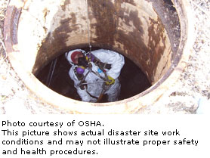
Operation specific sheets
Entry into Confined Spaces Many confined and enclosed spaces will need to be entered because equipment they contain needs to be assessed, repaired, or replaced prior to resuming operations. Spaces may also need to be entered because they have been impacted by contaminated water, and/or sand and sludge. Hurricane-related events might introduce hazards or potential hazards into confined spaces, such as a potential hazardous atmosphere due to the presence of decomposing organic matter, hazardous chemicals in the space, or performance of operations in the space, such as welding, cutting, or burning.

Slide 17
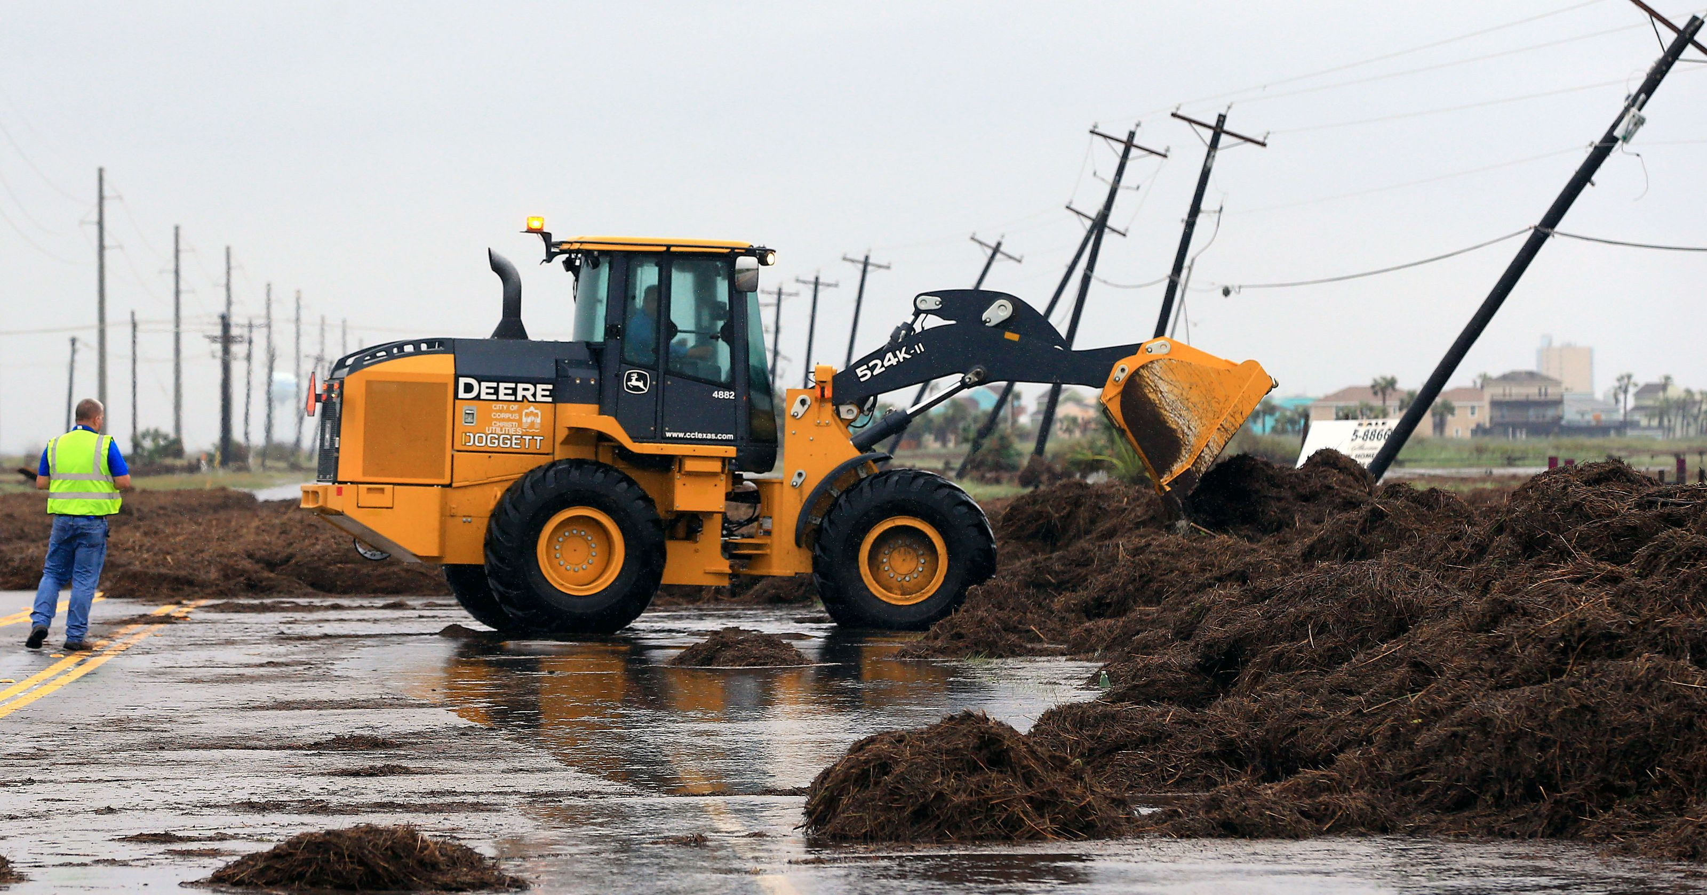
Operation specific sheets
Heavy Equipment and Powered Industrial Truck Use Heavy equipment (bulldozers, backhoes, front-end loaders, dump trucks, aerial lifts) will be used extensively during most operations, exposing the response and recovery workers in and around the equipment to struck-by hazards.
Notes:
As a result of Hurricanes Katrina and Rita (2005), water, sand, and sludge have impacted streets and buildings causing many to become structurally unsound and in need of assessment and repair. In addition, the high winds and floodwaters left extensive amounts of debris, which will require clearing. To address these conditions, many operations will be conducted in roadways, where response and recovery workers may be exposed to vehicular traffic. In addition, heavy equipment (bulldozers, backhoes, front-end loaders, dump trucks, aerial lifts) will be used extensively during most operations, exposing the response and recovery workers in and around the equipment to struck-by hazards.

Slide 18
Heavy Equipment Safety
Traffic patterns
Right-of-way
Equipment signals
Blind spots around operating heavy equipment

Slide 19
Powered Industrial Trucks (PIT)
30,000 Related Injuries a Year
Inattention
Distraction
Excessive speed
Poor driving habits
Lack of training
85 Fatalities a year *
2,162 cited violations *
*** 2017 – P.I.T. are in the Top 10 most cited OSHA violations

Slide 20
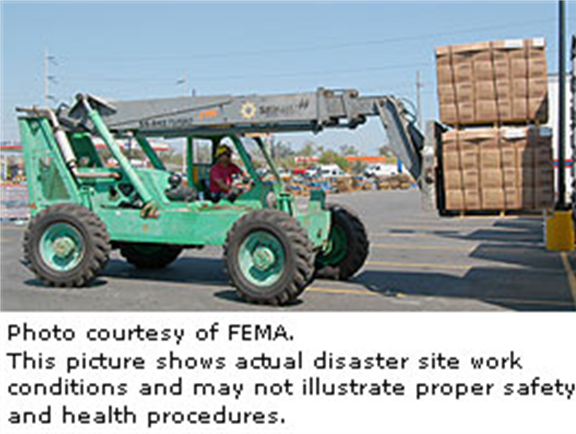
Circumstances of Injury
How Most Injuries Occur:
Overloading causing turnover
Load instability causing turnover
Obstructions in the path of travel or lift
Using forklift outside of design limitations
Striking a pedestrian

Slide 21
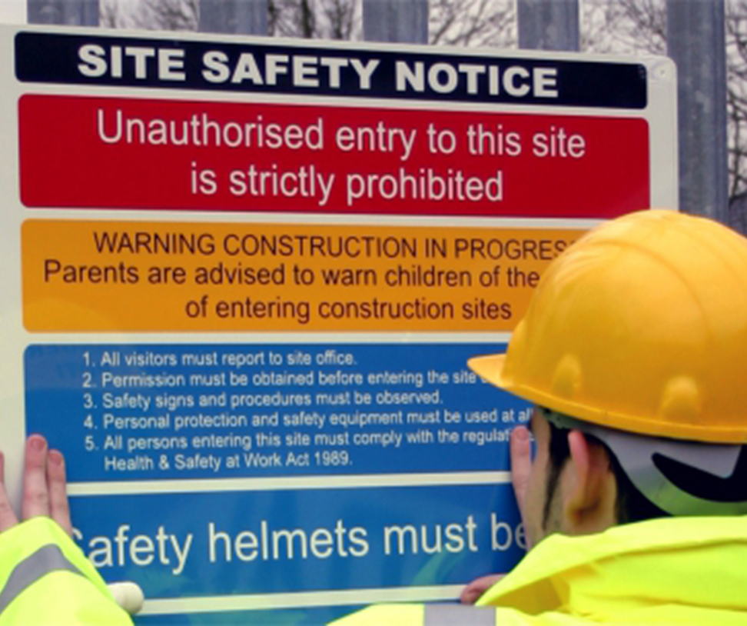
Example of Standing Orders
Eating, smoking, and drinking prohibited within the work zone.
Lighters and matches are not allowed in the work zone.
Check in at the access entry point before entering the work zone.
Safety helmets must be worn.

Slide 22
Optimum Level of Safety
Types of risk and hazards to which they will be exposed
Building construction types and characteristics
Manner of building collapse
Indicators of compromised structure integrity
Types of voids and areas of survivability
Personal protective safety equipment
Safety hazards that may be present at disaster sites that involve CBRNE agents
Safe zones and escape routes

Slide 23
Building Instability
Risks include:
Falling material and flying objects
Secondary collapse of unstable structures
Fire and explosion
Fall or tripping hazards from uneven surfaces
Exposure to smoke, dust, and particulates
Excessive noise
Unstable, partially collapsed, or totally collapsed structures
Different, extended, or unusual chain of command
Extended pre-job, or pre-task orientation period
Unexpected, unknown, undocumented hazardous material

Slide 24
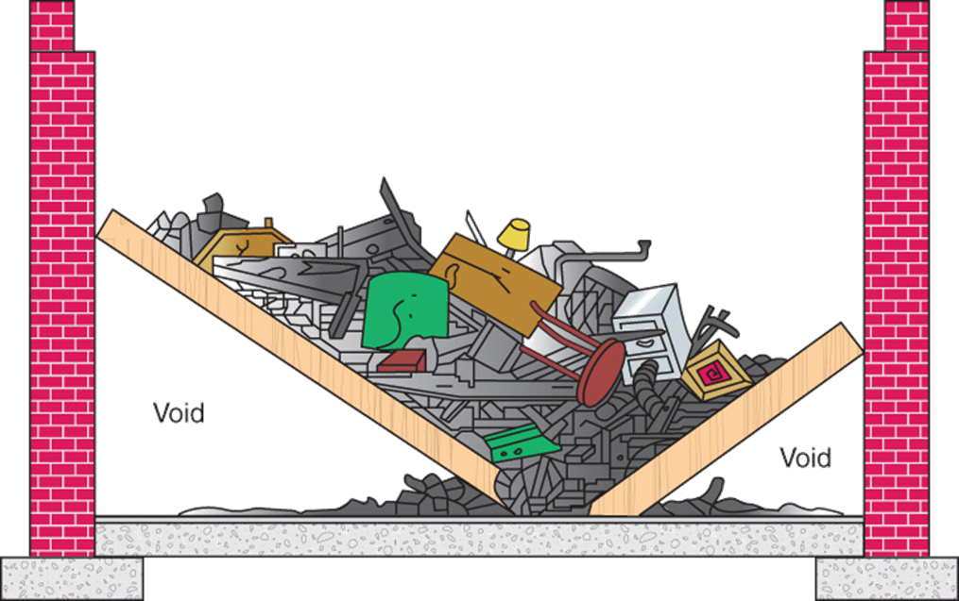
Types of Structure Collapse
V-Shaped
Survivability in the void spaces.
Supporting walls will often be intact but can not be trusted.

Slide 25
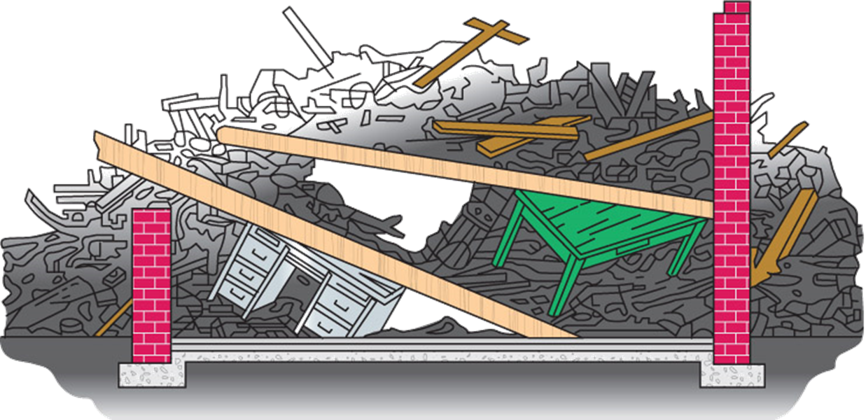
Types of Structure Collapse
Pancake Collapse
Void space is almost completely gone.
Survivability in this type of collapse is greatly reduced.

Slide 26
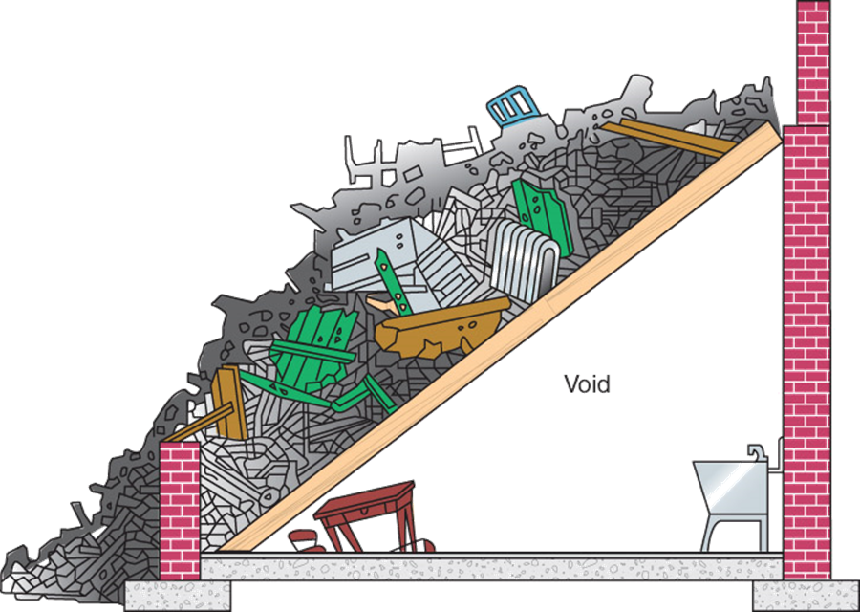
Types of Structure Collapse
Lean-to Collapse
Large void space greatly increases the survivability.
Like all collapsed structures, Lean-to Collapse exerts a great deal of weight and pressure on the supporting walls.

Slide 27
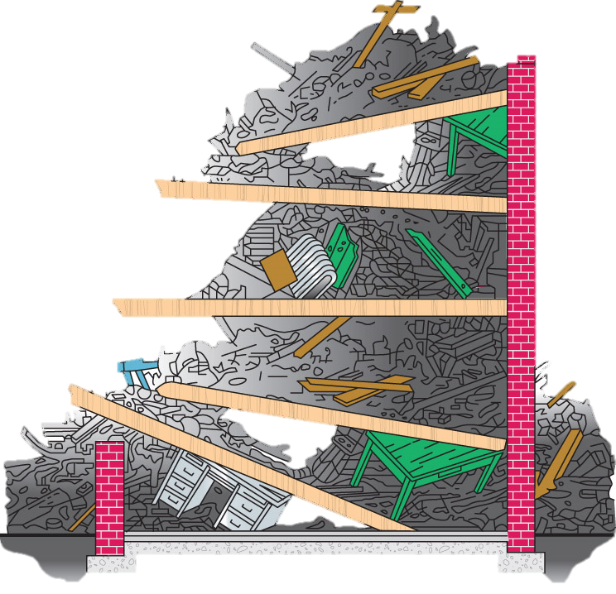
Types of Structure Collapse
Cantilever Collapse
Complex collapse with potential for a variety of collapse styles:
“A – Frame” Collapse
Inward / Outward Collapse
Cantilever Floor Collapse

Slide 28
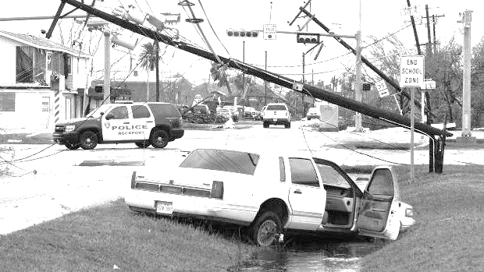
Energy Sources
Energy Isolation should be left to authorized personnel.
Lock Out Tag Out should be applied (if applicable).
Disaster sites require a great deal of CONTROL & VERIFICATION.
Lack of personnel accountability working in or around the site.

Slide 30
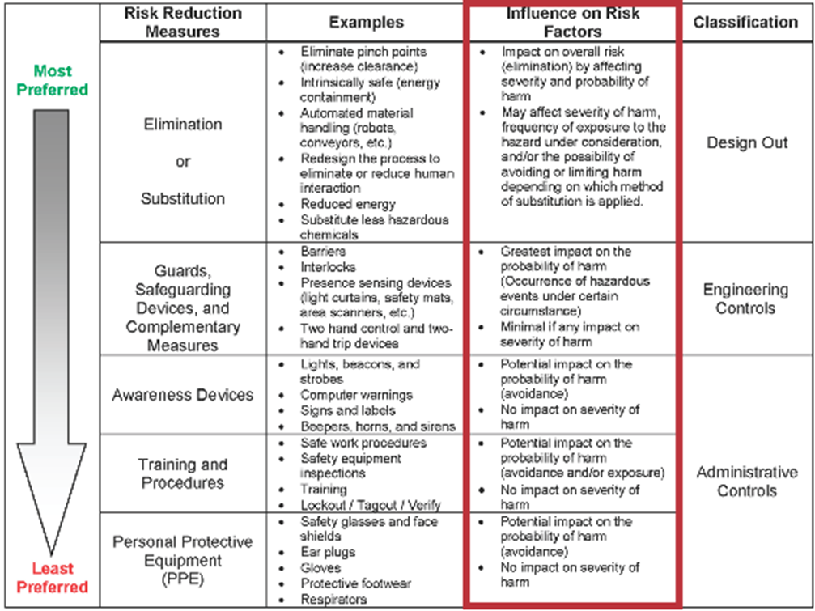
Work Practice Controls
Maintenance
Job Rotation
Monitoring
Training
Notes:
Work Practice Controls
An effective program for hazard prevention and control also includes safe and proper work practices that are understood and followed.
Key elements of a good work practice program include proper work techniques, employee training, regular monitoring, feedback, adjustments, modification, and maintenance.

Slide 31
ACTIVITY
Name TWO Infrastructure repair & restoration projects:
Roadway and Bridge Inspection and Repair
Sand/Sludge Removal
Community Floodwater Removal and Levee Repair
Restoring Electrical Utilities
Restoring Communications Systems
Restoring Water and Sewer Services

Slide 32
activity
“V” Shaped

Slide 33
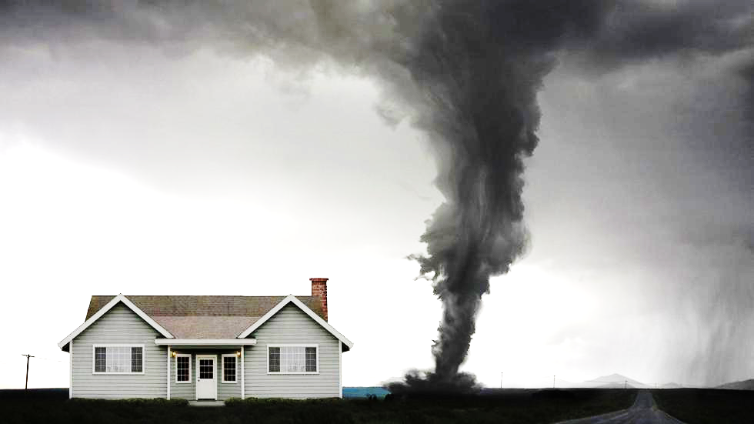
Dashboard
RESPIRATORY
PROTECTION

